Slide 1
Communication for Children who are Deaf- blind: An Overview of the Early Years

Slide 2
Deaf-Blindness
Deaf-blindness means concomitant hearing and visual impairments, the combination of which causes such severe communication and other developmental and educational needs that they cannot be accommodated in special education programs solely for children with deafness or children with blindness. 34 CFR 300.8 (c) (2)

Slide 3
Communication
Communication is the process of exchanging information. It is the way we share our knowledge, needs, wishes, and feelings.
Individuals with vision and hearing loss may show communication skills in many ways. This communication may take the form of body movement, gestures, facial expressions, vocalizing, use of objects or people, pointing to pictures, or more formal systems.

Slide 4
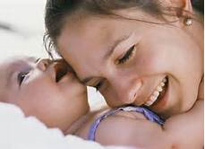
Meaningful Communication
The most fundamental aspect of communication is based on a child’s bond with their caregiver.

Slide 5
Effective Communication with children who are deaf-blind begins when…
The emotional attachments of young or developmentally young children begin when they show preferences for a particular familiar person. They tend to seek proximity to those people, especially in times of distress, and they have the ability to use familiar adults as a secure base from which to explore the environment.

Slide 6
Hearing Loss, Visual Impairments and Communication
When a child has both a visual impairment and hearing loss, it may be more difficult to understand what she/he is trying to tell you and you may be unsure how you can best communicate and interact with him/her.

Slide 7
Perspectives
Professionals and families need to gain an understanding of various communication techniques, strategies and modes in order to give the child an individualized and appropriate communication system that reflects the child's assessed needs and respects the family's choice.

Slide 8
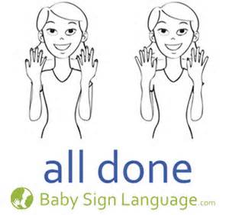
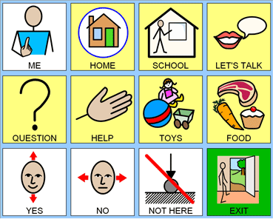
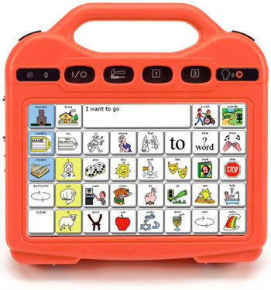
Continuing Perspectives
Children should be provided with multiple communication approaches including, speech, total communication, sign language, pictures and augmentative communication methods in both home and school environments.

Slide 9
Understanding What Works
Professional service providers must understand that all behavior has a communicative function and should not be a "problem." Children who are deaf-blind should have the opportunity to express their needs and frustrations without being judged.

Slide 10
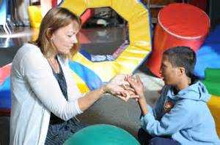
Communication Facilitation
Each child who is deaf-blind should be provided a communication facilitator (certified interpreter, trained intervener, teacher assistant, etc.).

Slide 11
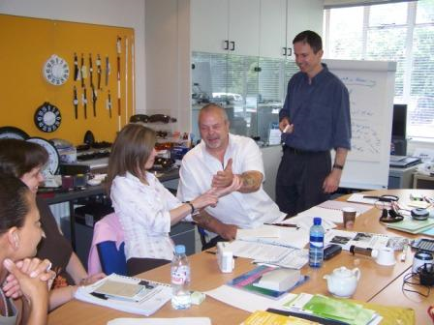
Training Sessions
Training should be provided to ensure that a variety of people are able to communicate with the child.

Slide 12
Response Time
Children and adults who are deaf-blind should be given the right to communicate and be "listened to" with adequate time to respond.

Slide 13
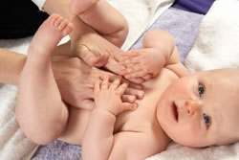
Ways to Develop Effective Communication
Touch- is the beginning of communication and the starting point for shaping the child's learning and development as well as promoting an intimate bonding experience for you both.

Slide 14
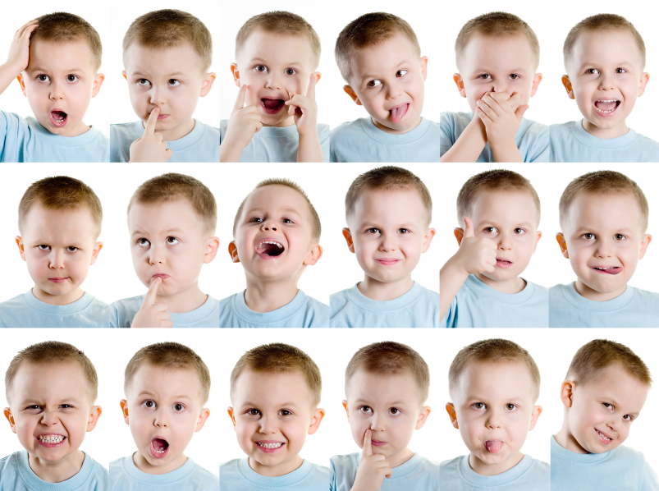
Behaviors
Behaviors- can be physical movements, sounds, facial expressions, eye gaze that communicate a physical state (e.g., comfort, hunger, sleepy). Care-givers and professionals use these behaviors to respond to the child's needs forming the beginnings of communication.

Slide 15
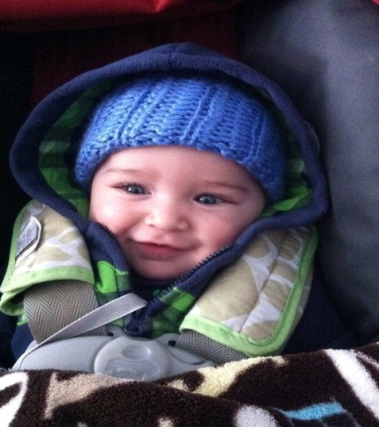
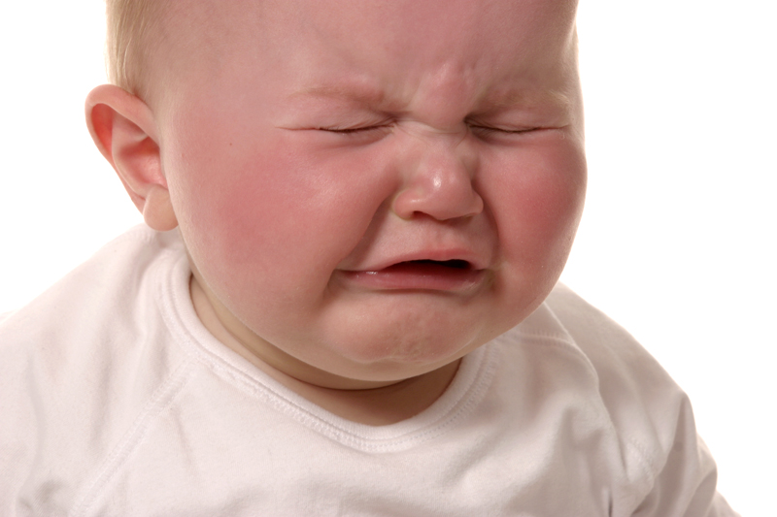
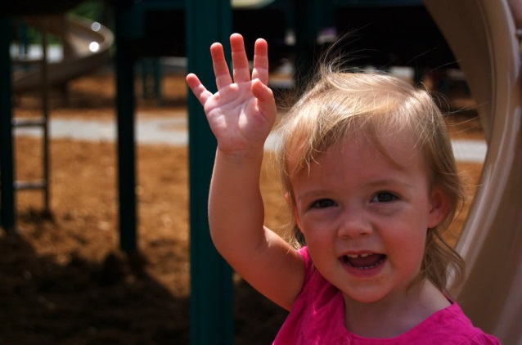
Pre-Symbolic
Pre-Symbolic-As the child moves from infancy, behaviors intensify as a means of communication. These behaviors can become unique to each child and will usually be related to how the individual child feels or be an expression about current experience. Examples are things like crying, cooing, pushing away, smiling, shaking the head, or waving.

Slide 16
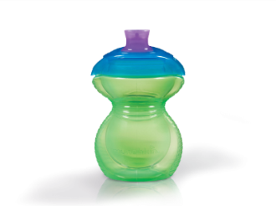
As The Child Grows, Communication Changes..
Concrete Symbols-Pictures, drawings, objects, parts of objects, gestures or sounds can be used to communicate about a person, activity, place or thing. These symbols look like, sound like or feel like what they are meant to represent.
  Object Cues:
  The toilet paper roll signals "Let’s go to the bathroom."
  Tangible Symbols:
  Whole object: a cup. (Represents concept of drink)

Slide 17
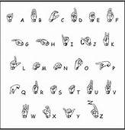
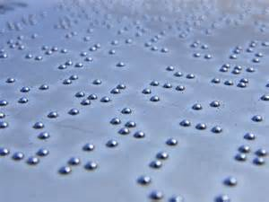
Abstract Symbols
Abstract Symbols-These are forms of communication that involve speech, manual signs, Braille or print that can be used to communicate intentions and ideas both simple and complex. More developed language skills combine at least two abstract symbols of any type. http://vimeo.com/9390479

Slide 18
Elements of a Good Conversation
Mutual Respect
Emotional Comfort
Physical Comfort
Conversing in Motion
Topics of interest to the Child
Good Mutual Touch

Slide 19
Teaching Effective Communication
Teach the child to face the person he/she is communicating with.
Teach the child to communicate wants, needs, and opinions without being aggressive or pushy.
Teach the child to be sensitive to the messages communicated in tone of voice and body language.
Provide opportunities for the child to communicate with different people in different environments.
Help the child expand the functions of communication.

Slide 20
Modes of Communication
Oral/Aural (Speech/Hearing)
Sign Language
Haptic/Tactile Sign
Fingerspell
Symbols/Picture symbols/communication notebook
Cued Speech

Slide 21
More Modes of Communication
Total Communication
Braille
Gestures
Facial expressions
Tadoma
Object Communication/Calendars
Visual Communication

Slide 22
Service Providers
Teacher of the Visually Impaired
Teacher of the Hearing Impaired
Interpreter
Speech Language Pathology
Intervener
Orientation and Mobility Specialist
Deaf-blind Specialist
http://www.youtube.com/watch?v=F8DiZbCu3TM
(This use of this video is not intended to endorse the institution, but to provide information and a glimpse of deaf-blind communication and service providing.)

Slide 23
Resources
Perkins School for the Blind
www.perkinselearning.org
Helen Keller National Center for Deaf blind Youth and Adults
http://www.hknc.org/
American Foundation for the Blind
http://www.afb.org/default.aspx
National Consortium for Deaf blindness
https://nationaldb.org/

Slide 24
Resources
American Association of the Deaf-Blind
http://www.aadb.org/
National Family Association for the Deaf blind
http://nfadb.org/

Slide 25
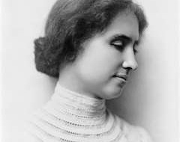
Once I knew only darkness and stillness... my life was without past or future... but a little word from the fingers of another fell into my hand that clutched at emptiness, and my heart leaped to the rapture of living.
Helen Keller

